Slide 1
Geometric Interpretation of BSTs
Matt Asnes and Harrison Kaiser

Slide 2
Part I: Some Review

Slide 3
The Model
BSTs are data structures reacting to a series of operations
Insert, search, delete, merge, etc.
Each operation has an argument
e.g. insert 10, delete 5, search 10, …
Each operation starts at the root
At each step:
Move between adjacent vertices
Perform a rotation
Eventually we access to argument of the operation
Access: find & report back, insert, delete

Slide 4
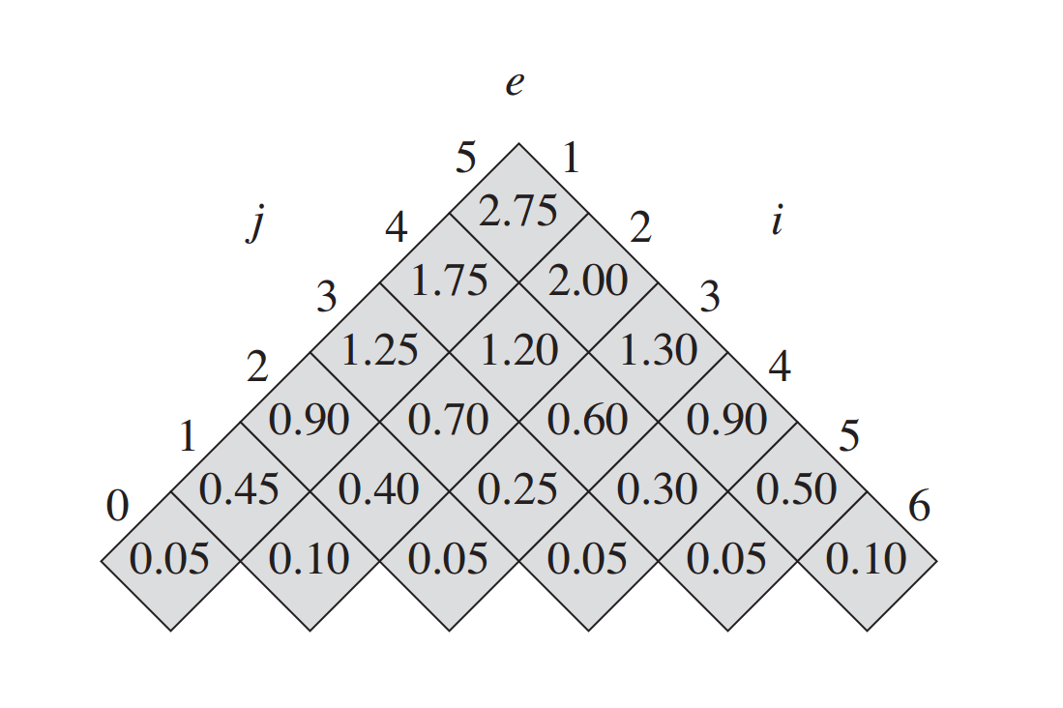

BST Optimality
Given a known set of operations, we can calculate
But for an unknown set of operations, what tree reacts the best?
Can be expressed mathematically…
Source: CLRS, ch. 15.6

Slide 5
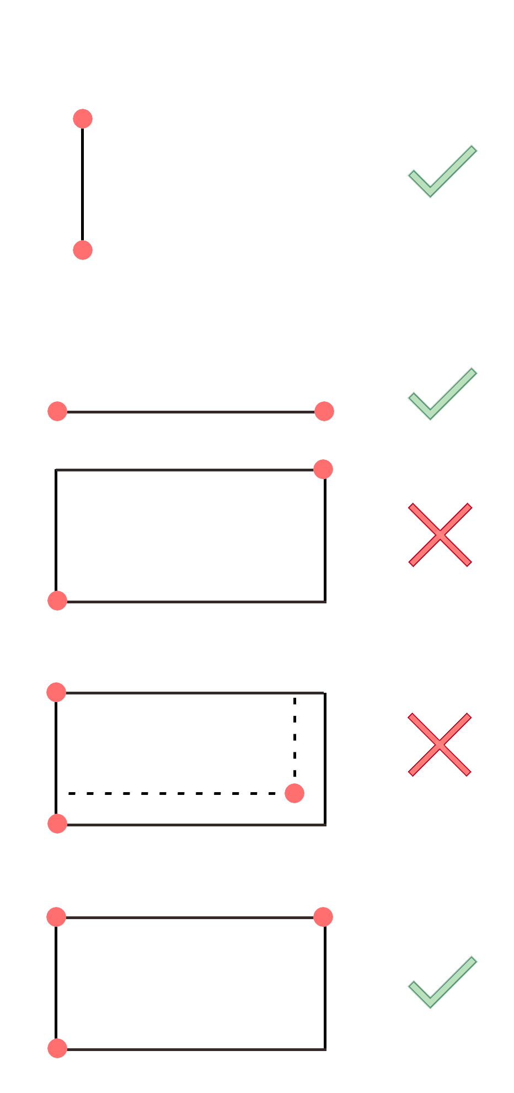
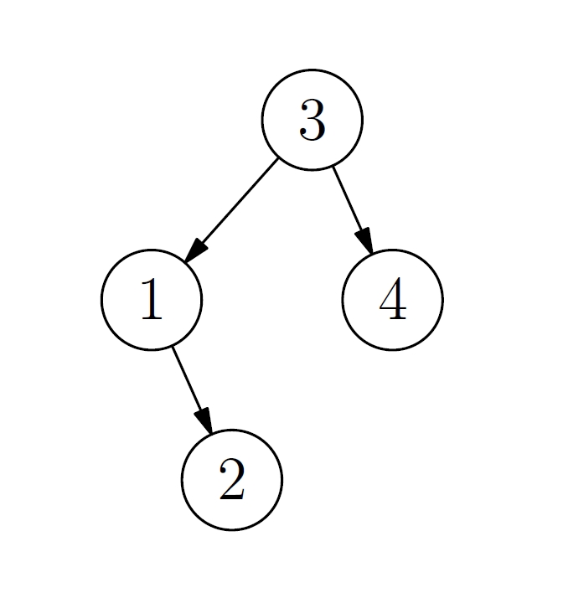
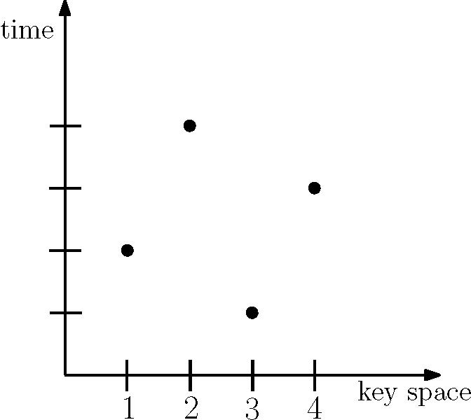
Arborally Satisfied Point Sets
For any pair of points:
If the two points form a rectangle:
There exists a third point inside or on the boundary of that rectangle
Translation to BSTs:
In 2D
x-axis: values being accessed
y-axis: operation # of access
Source

Slide 6
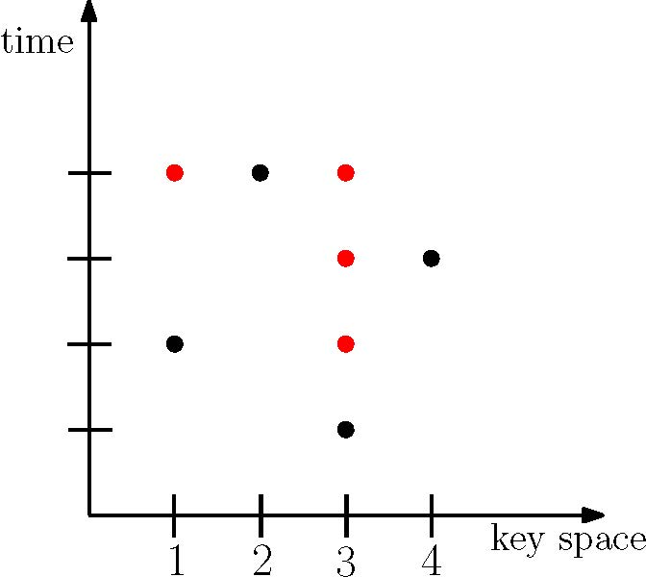
Arborally Satisfied Point Sets

Slide 7
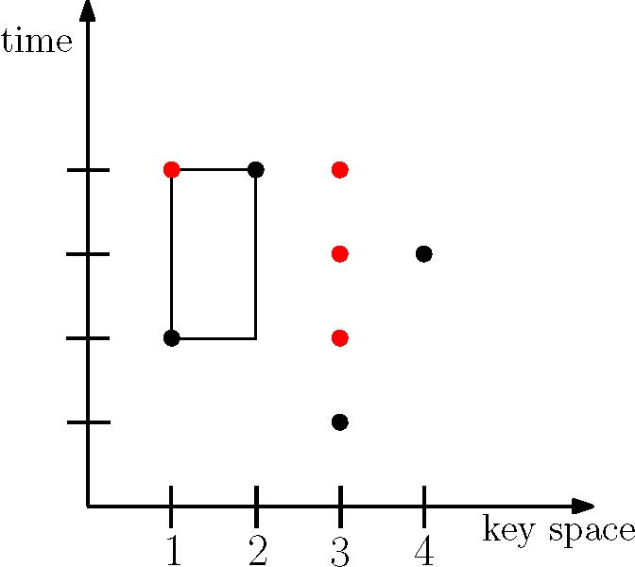
Arborally Satisfied Point Sets

Slide 8
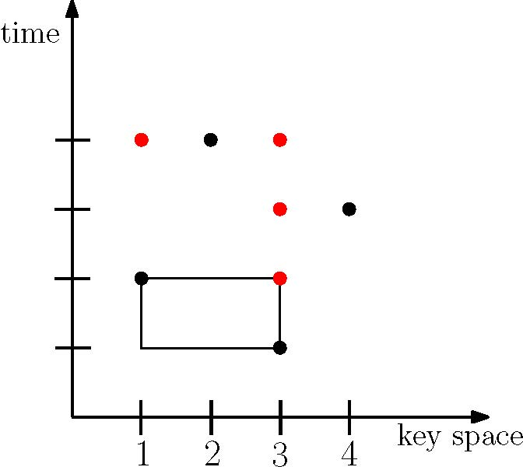
Arborally Satisfied Point Sets

Slide 9
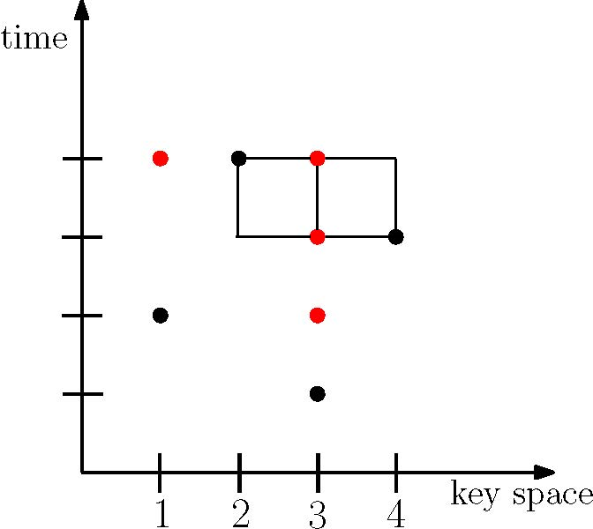
Arborally Satisfied Point Sets

Slide 10
Dynamic Optimality
A BST algorithm behaves deterministically on a sequence of operations
A sequence of operations defines a set of points in a 2D space
Plotting the accesses a BST makes along with the operations creates an arborally satisfied point set
Then optimality is equivalent to a minimization problem
“
”
Finding the best BST execution for a sequence of operations is equivalent to finding the minimum cardinality set of points that is arborally satisfied

Slide 11
Part II: Our Project

Slide 12
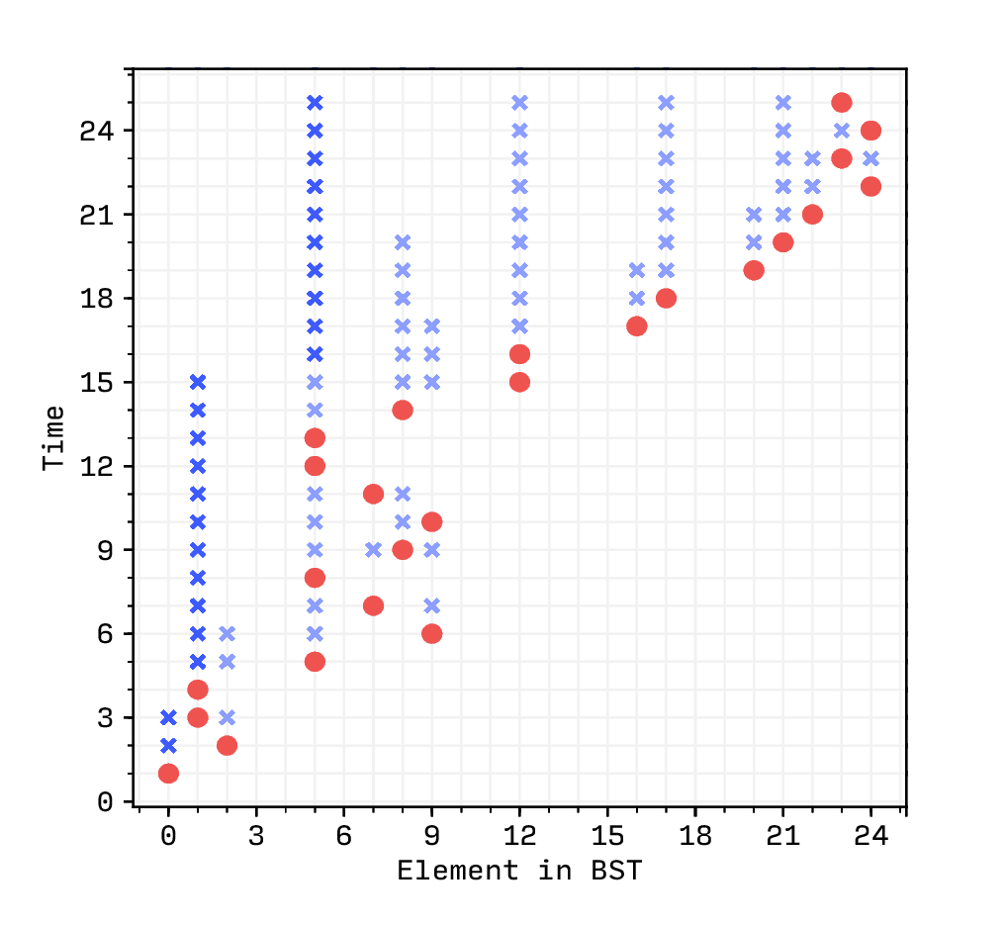
Generation of BST Plots
Program to generate point set plots of BST operations & accesses
Input: operations and their arguments
Input: a BST algorithm
Output: plots & analysis
Simple, RB, Splay, AVL, WAVL, OPT, Greedy

Slide 13
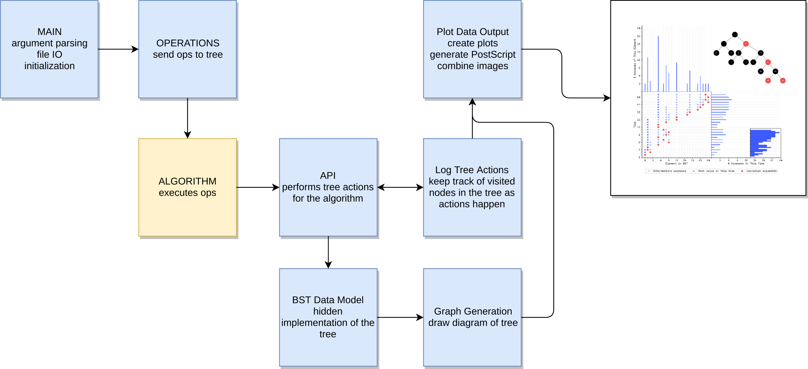
Architecture

Slide 14
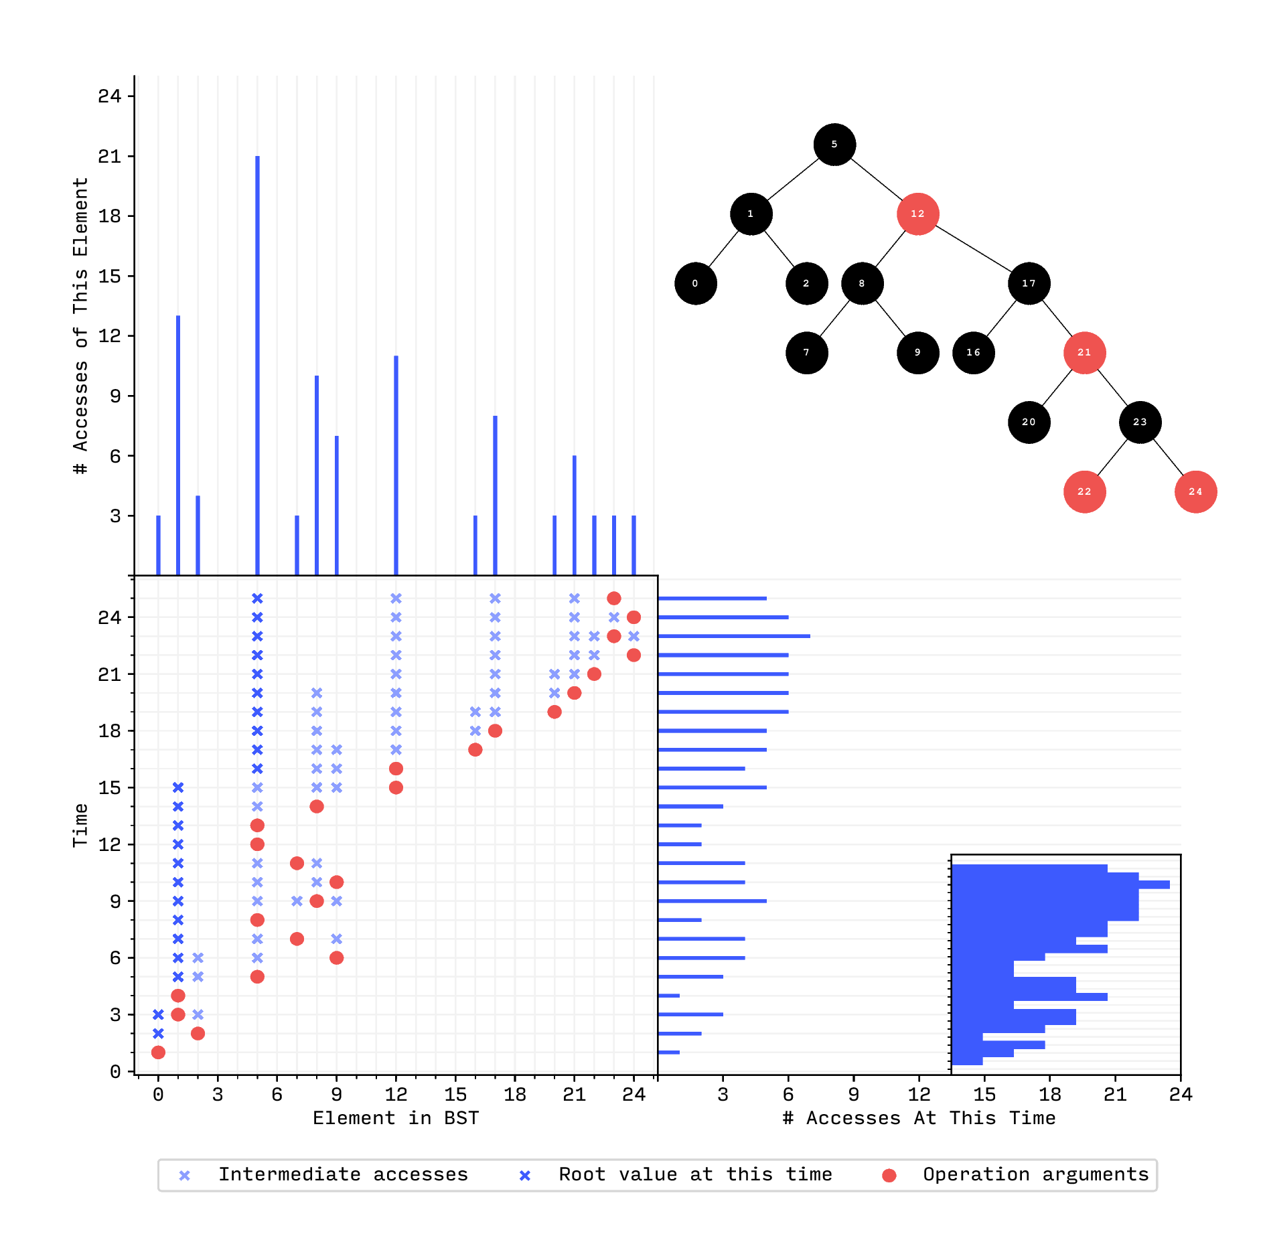
Output Format

Slide 15
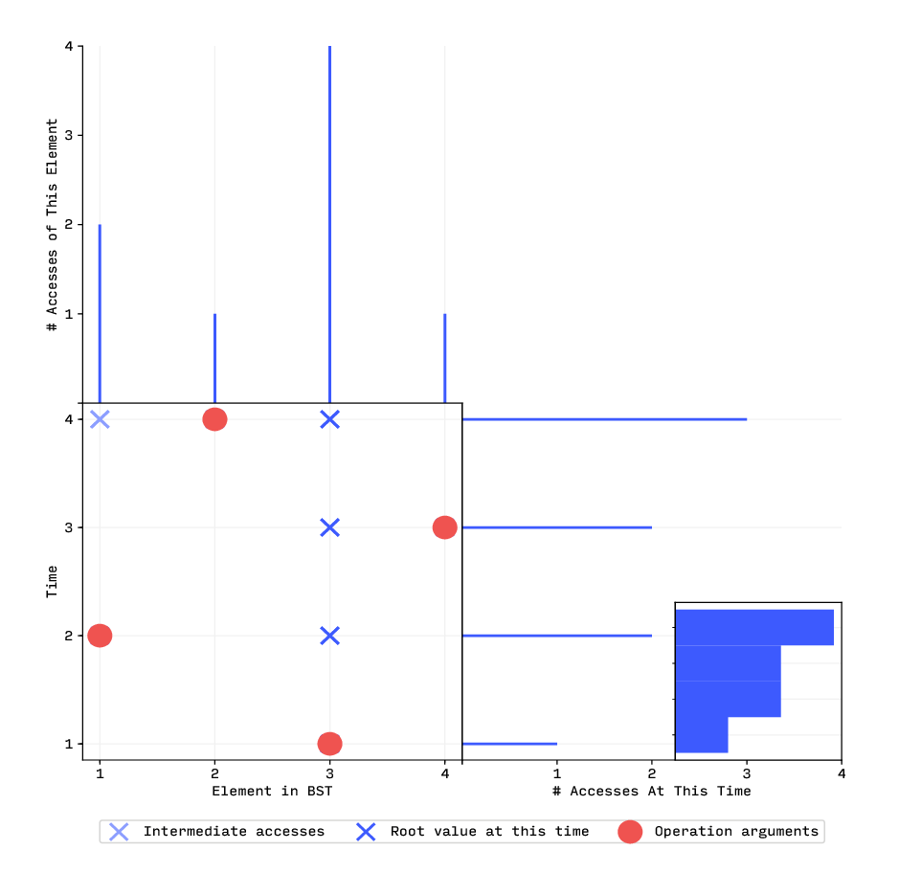
Arboral Satisfaction
# input
ins 3
ins 4
ins 1
ins 2

Slide 16
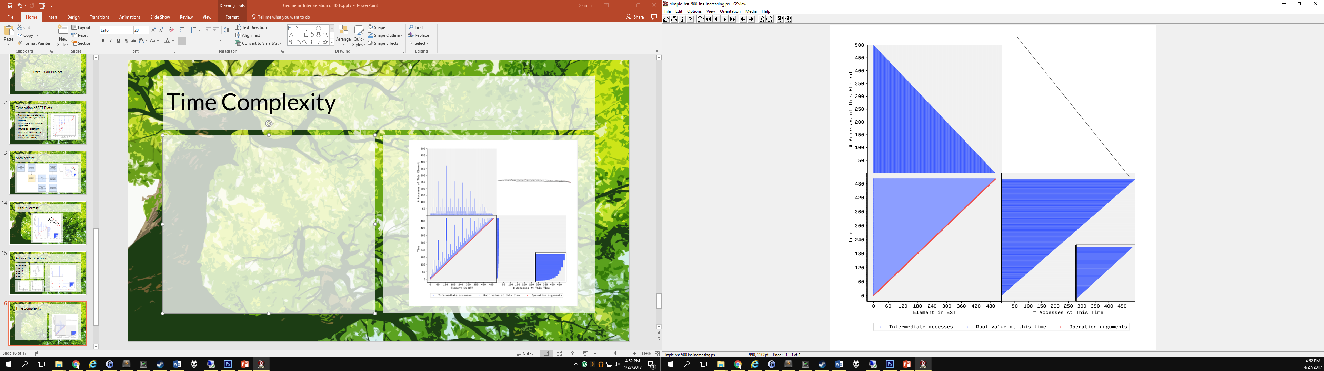
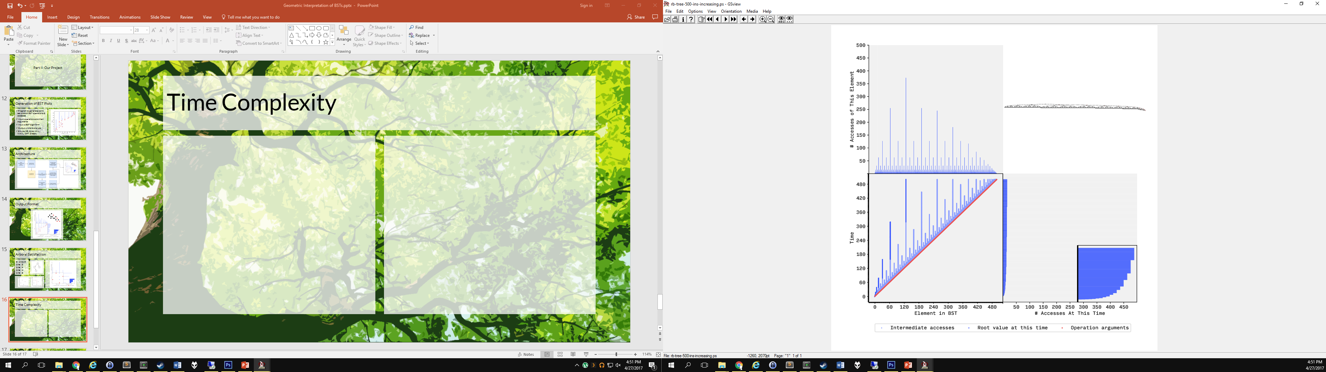
Time Complexity

Slide 17
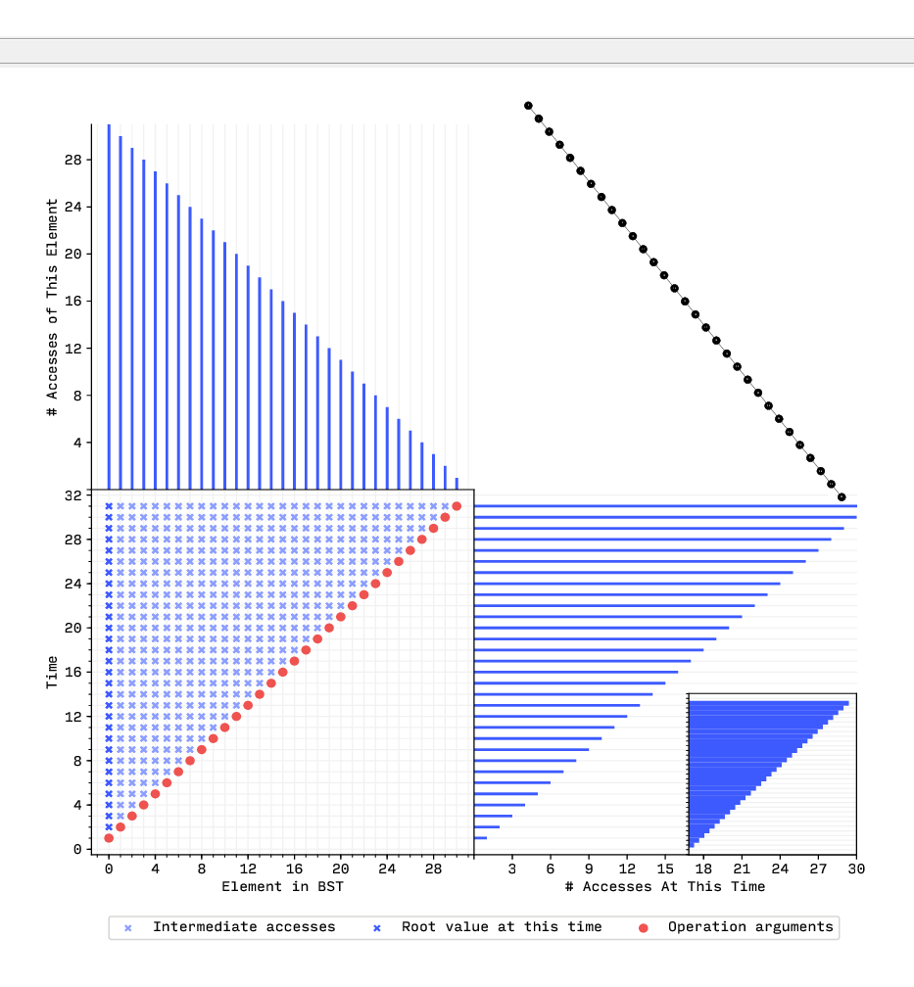
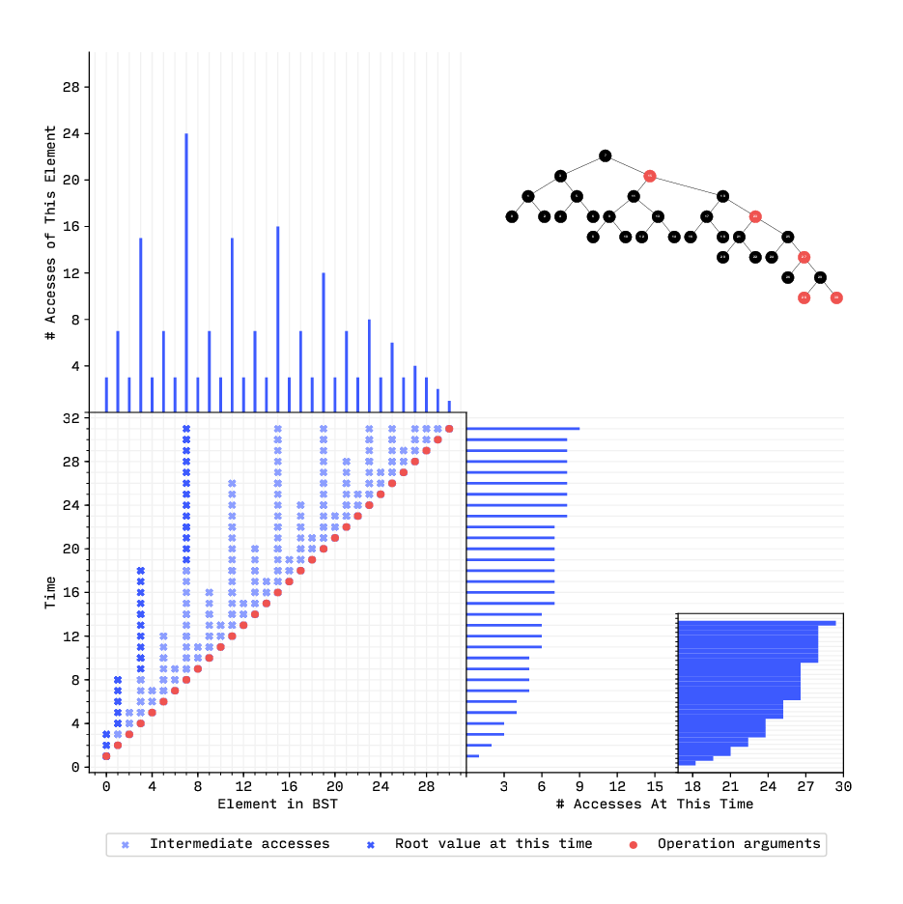
Time Complexity

Slide 18
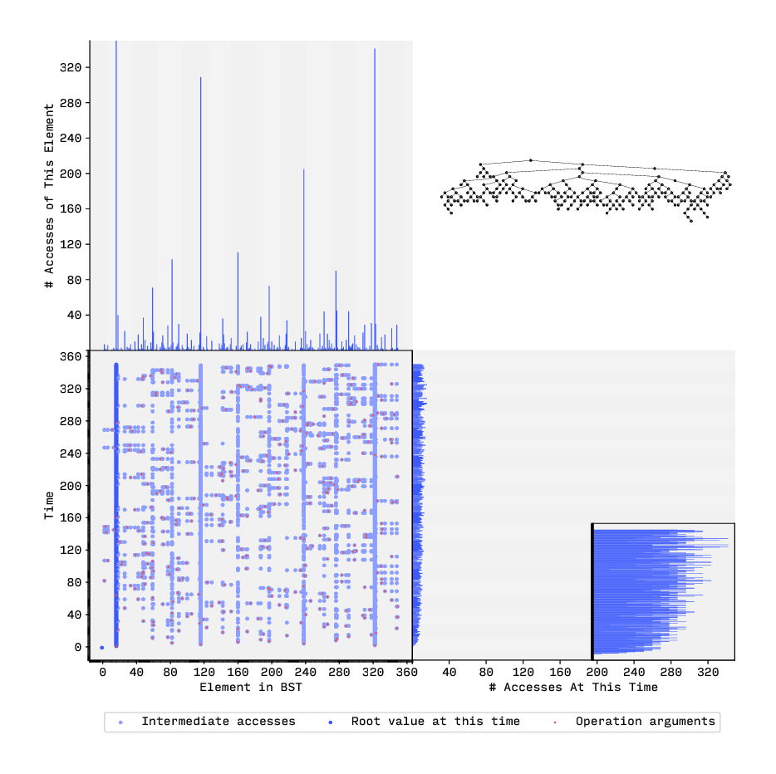
Simple BST, Random Inserts

Slide 19
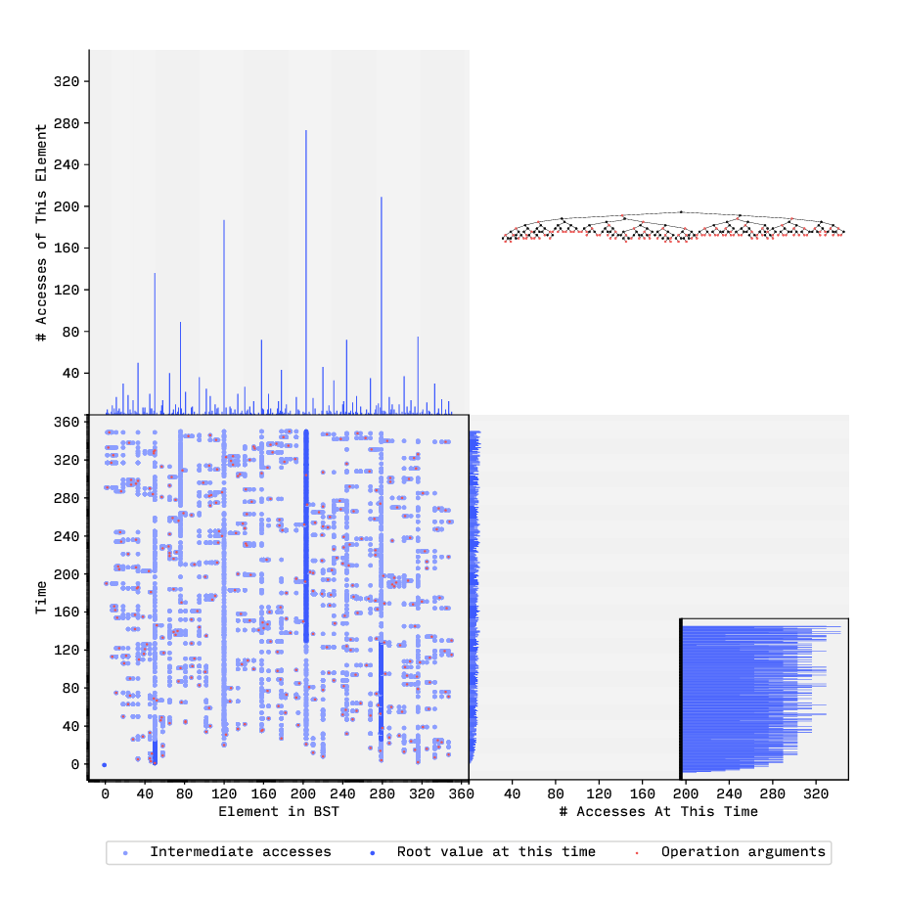
Red–Black Tree, Random Inserts

Slide 20
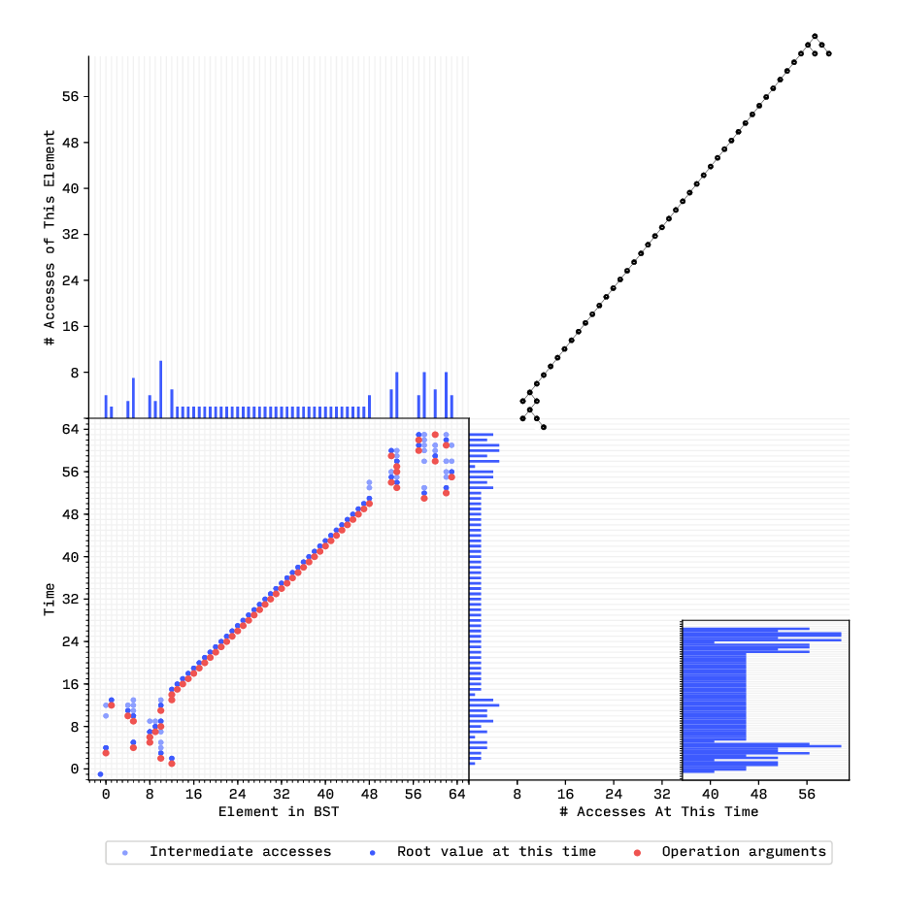
Splay Tree: Random Inserts, Then Increasing Inserts, Then Random

Slide 21
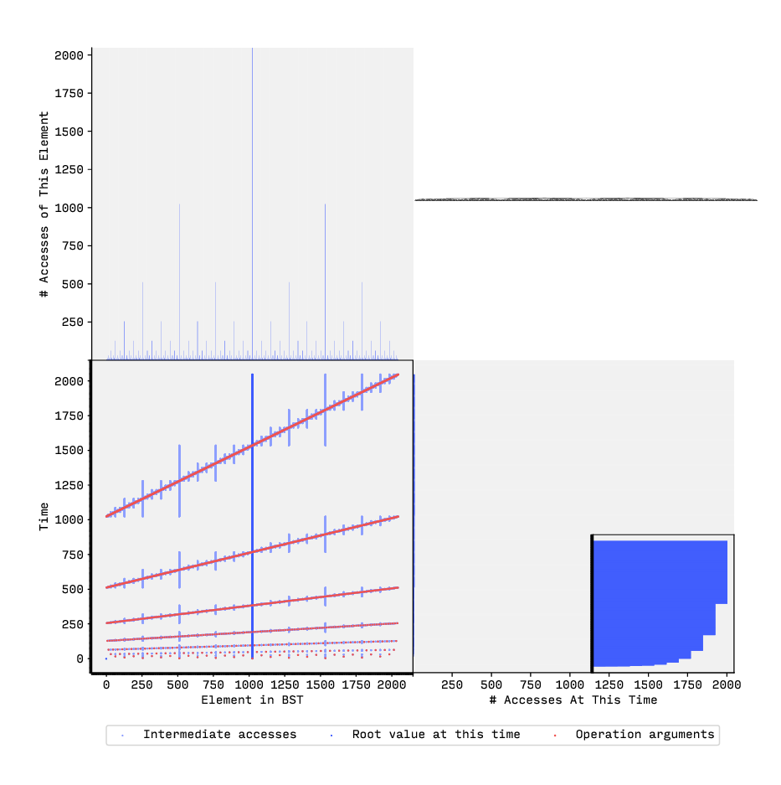
Simple BST: Perfectly Balanced Inserts

Slide 22
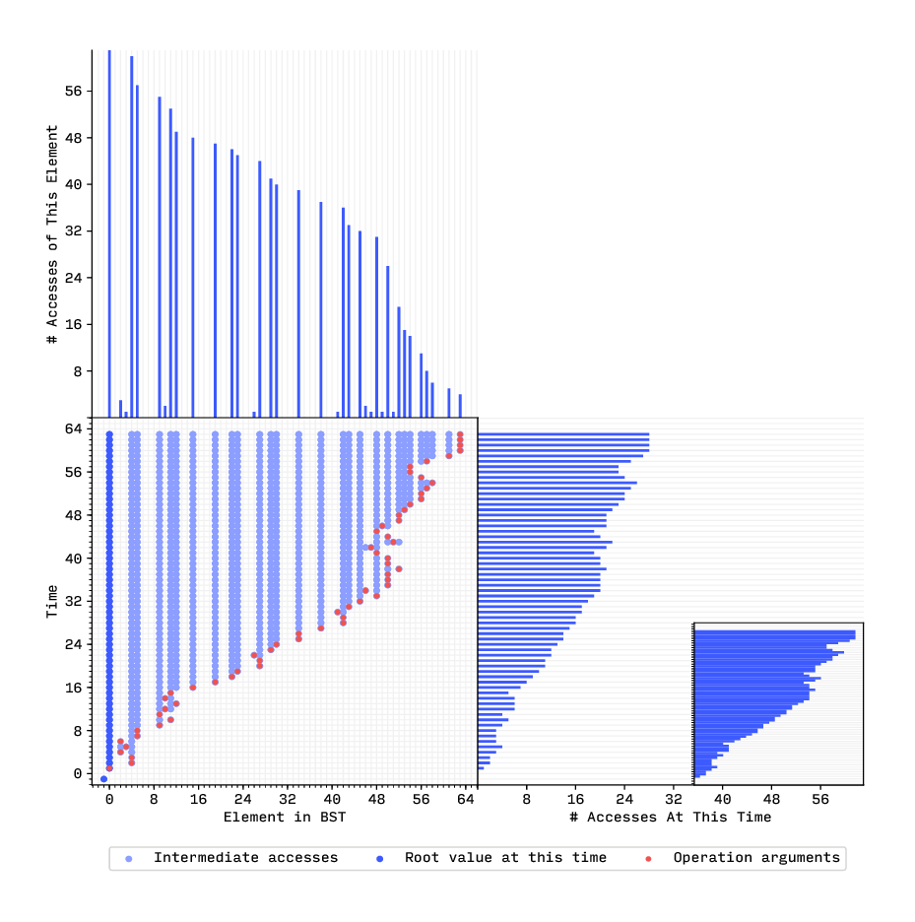
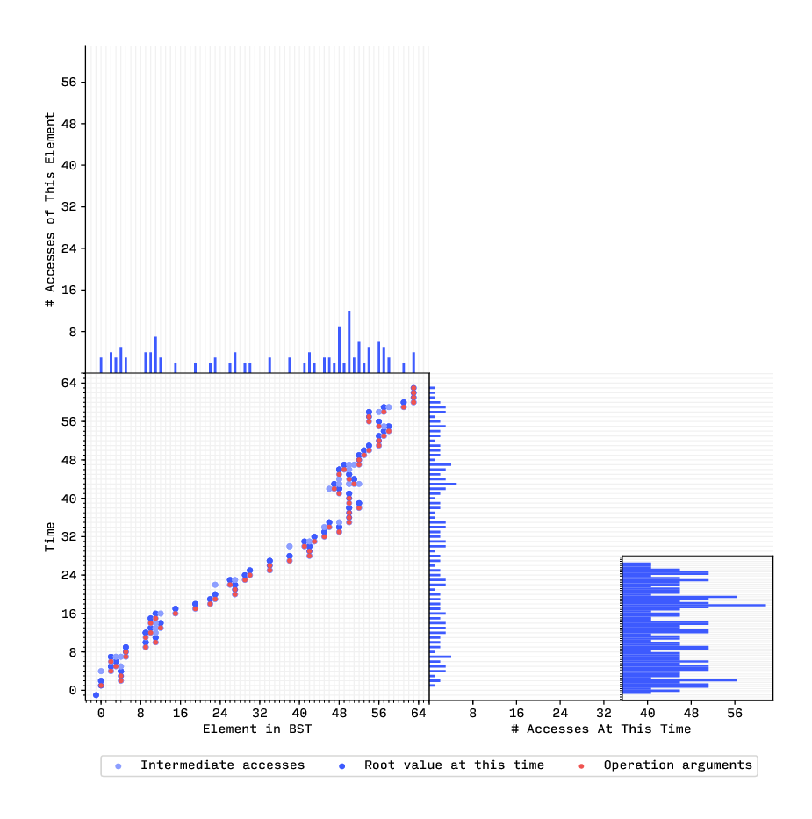
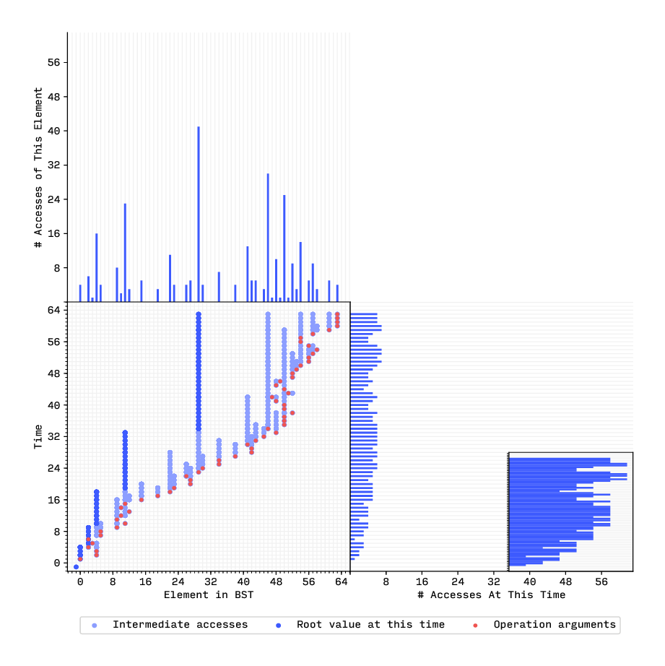
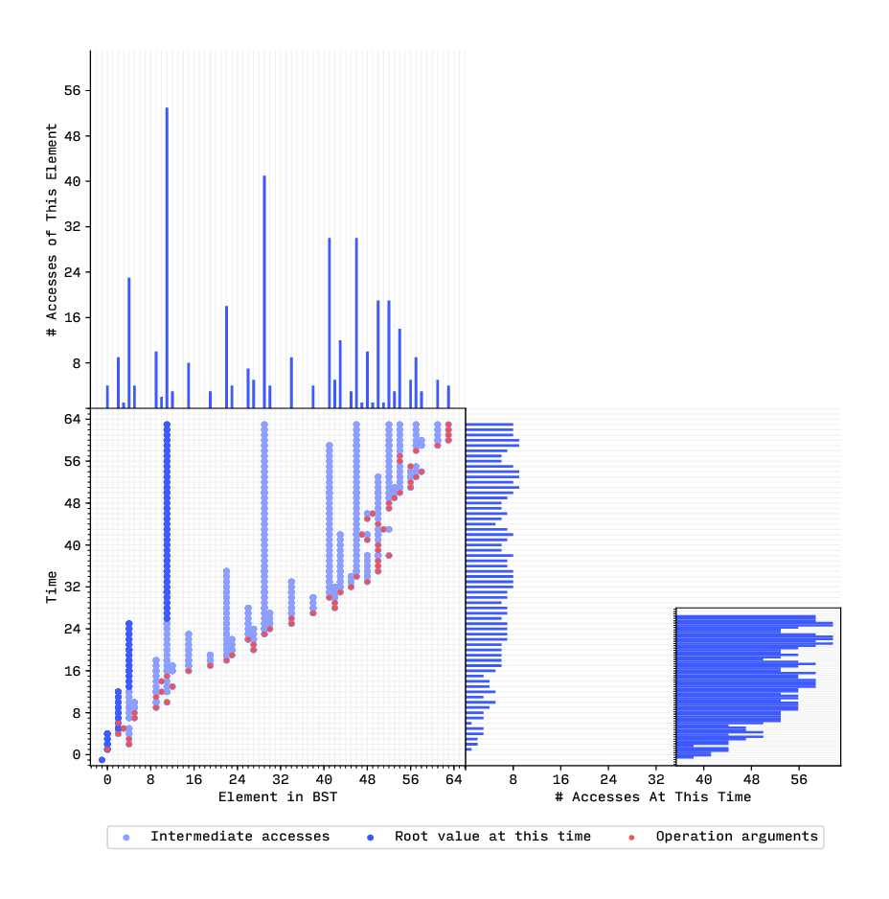
A Game: AVL, Splay, Simple, Red–Black

Slide 23
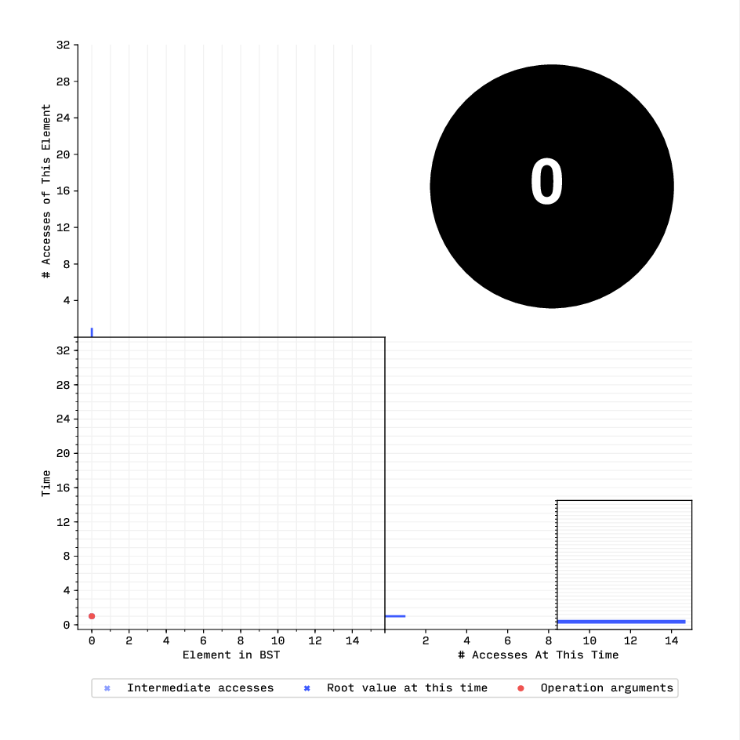
Splay Tree: Increasing Inserts, Decreasing Searches

Slide 24
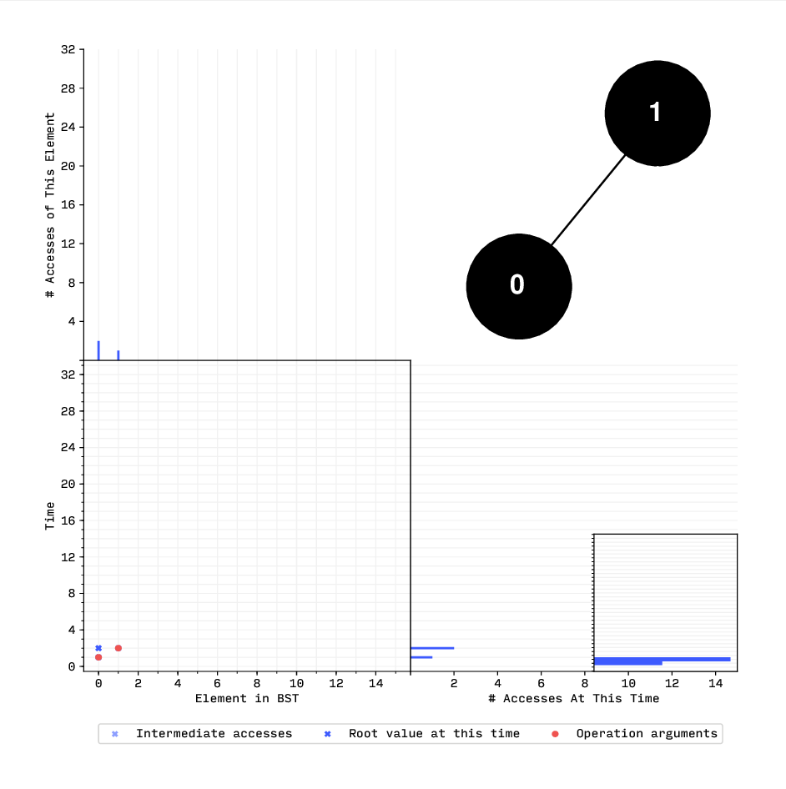
Splay Tree: Increasing Inserts, Decreasing Searches

Slide 25
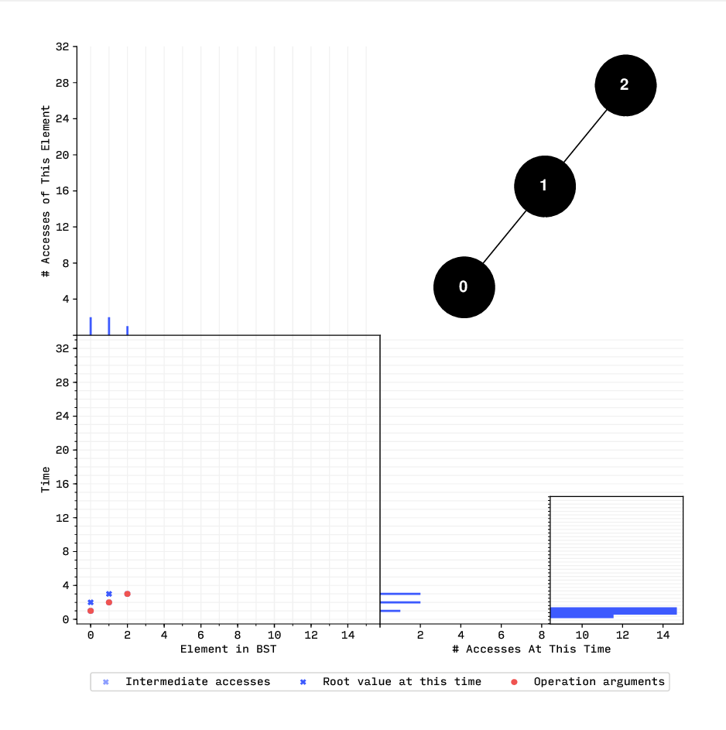
Splay Tree: Increasing Inserts, Decreasing Searches

Slide 26
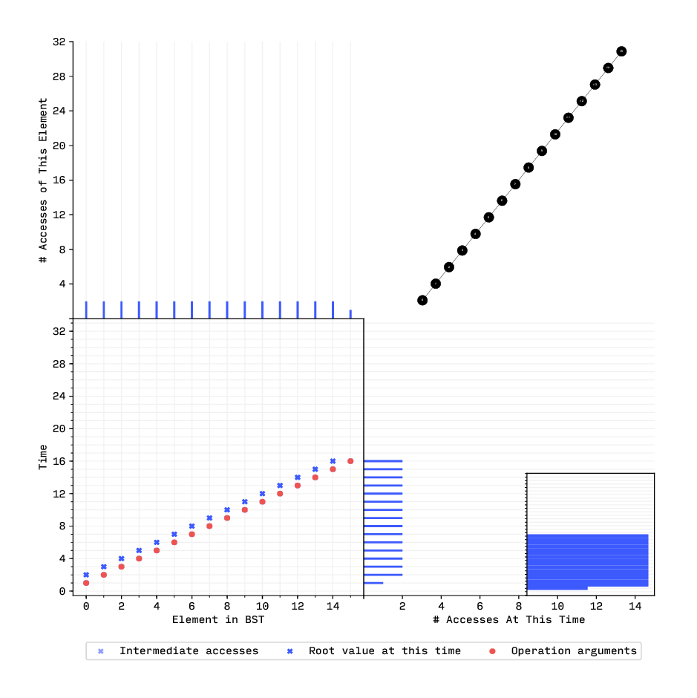
Splay Tree: Increasing Inserts, Decreasing Searches

Slide 27
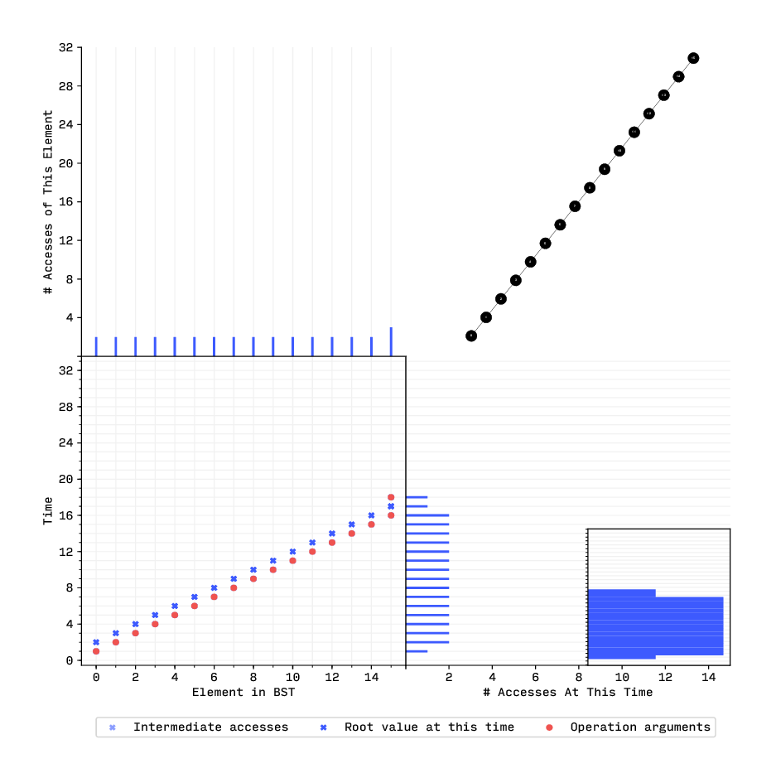
Splay Tree: Increasing Inserts, Decreasing Searches

Slide 28

Splay Tree: Increasing Inserts, Decreasing Searches

Slide 29
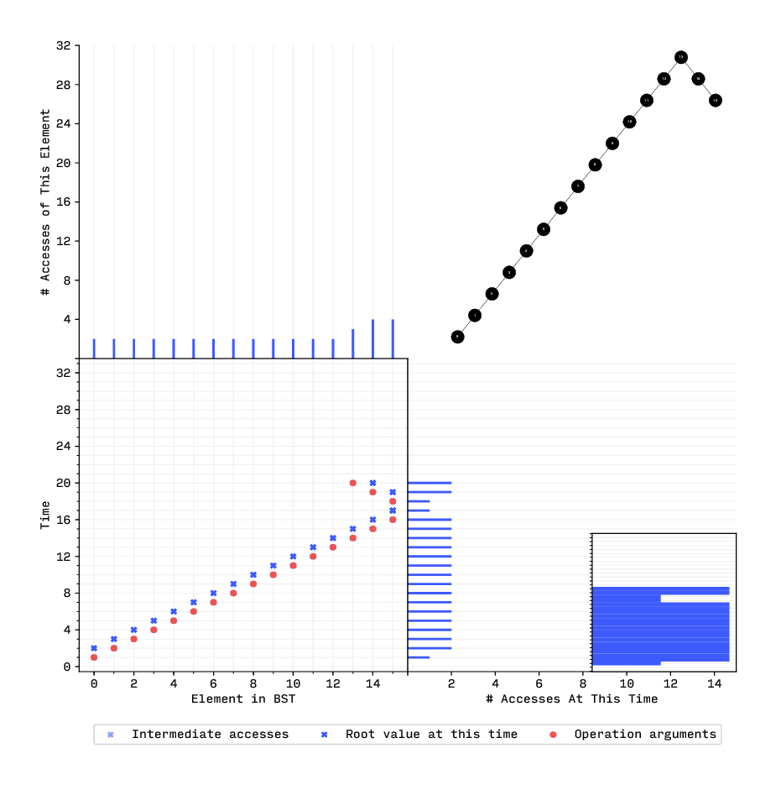
Splay Tree: Increasing Inserts, Decreasing Searches

Slide 30
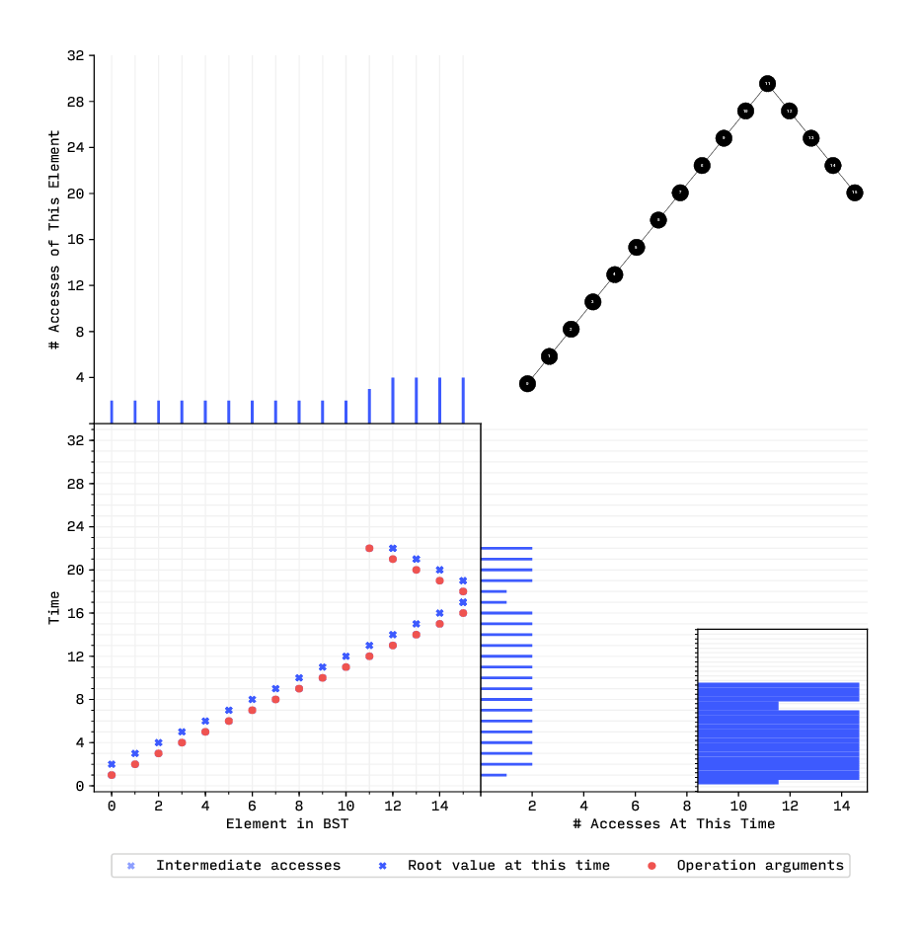
Splay Tree: Increasing Inserts, Decreasing Searches

Slide 31
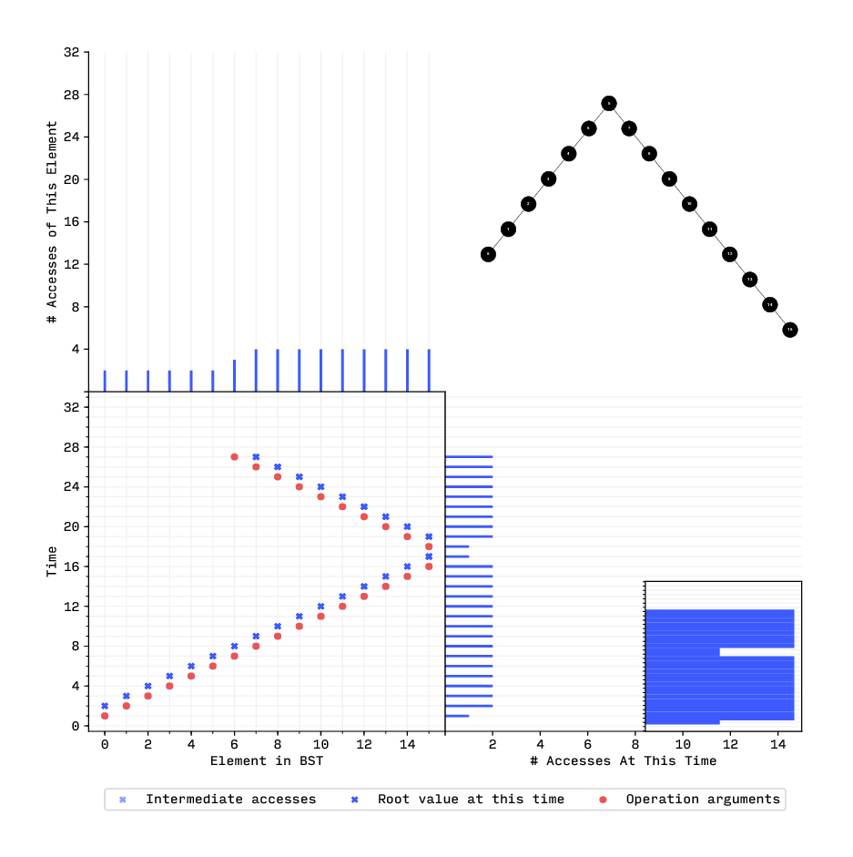
Splay Tree: Increasing Inserts, Decreasing Searches

Slide 32
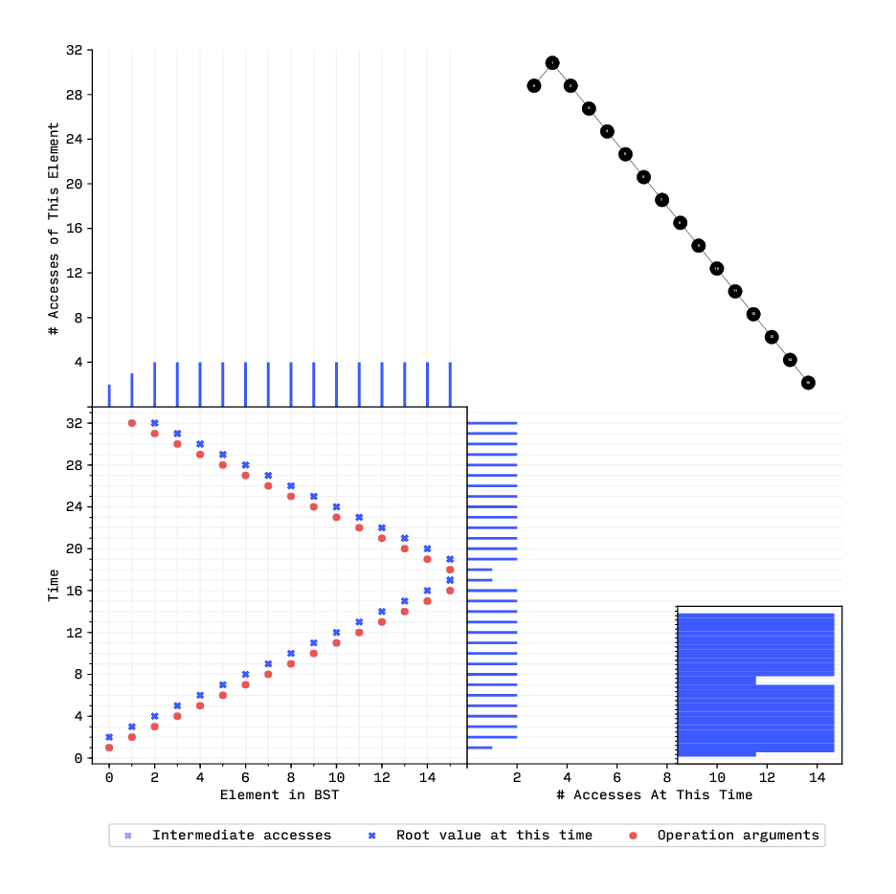
Splay Tree: Increasing Inserts, Decreasing Searches

Slide 33
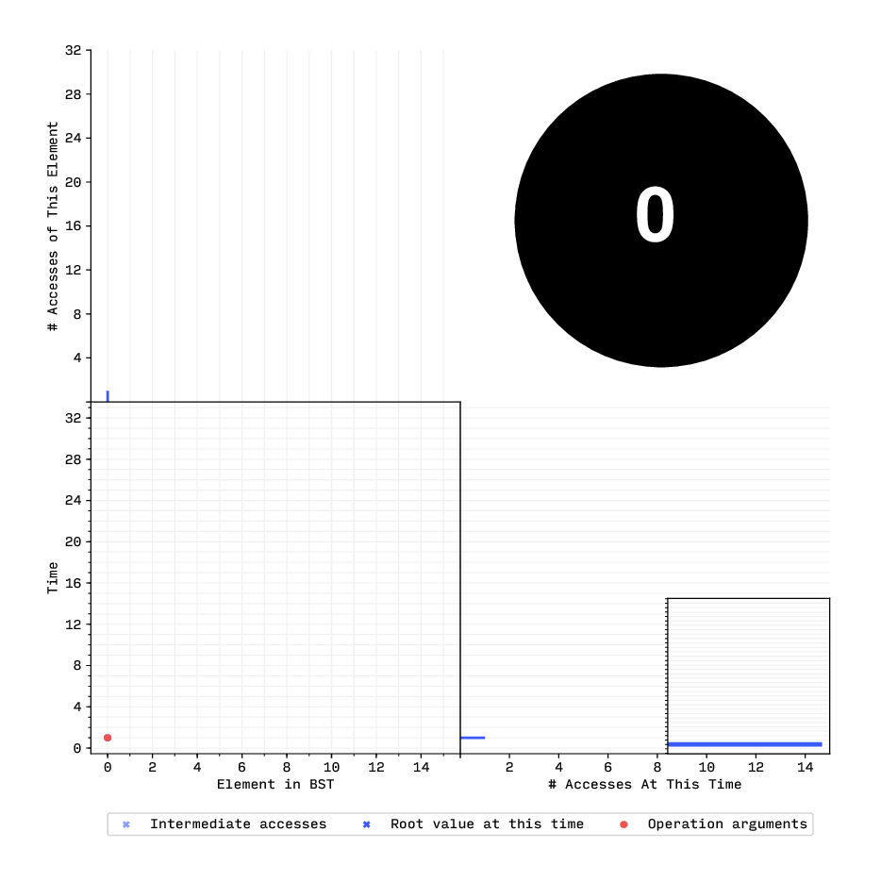
Splay Tree: Increasing Inserts, Increasing Searches

Slide 34
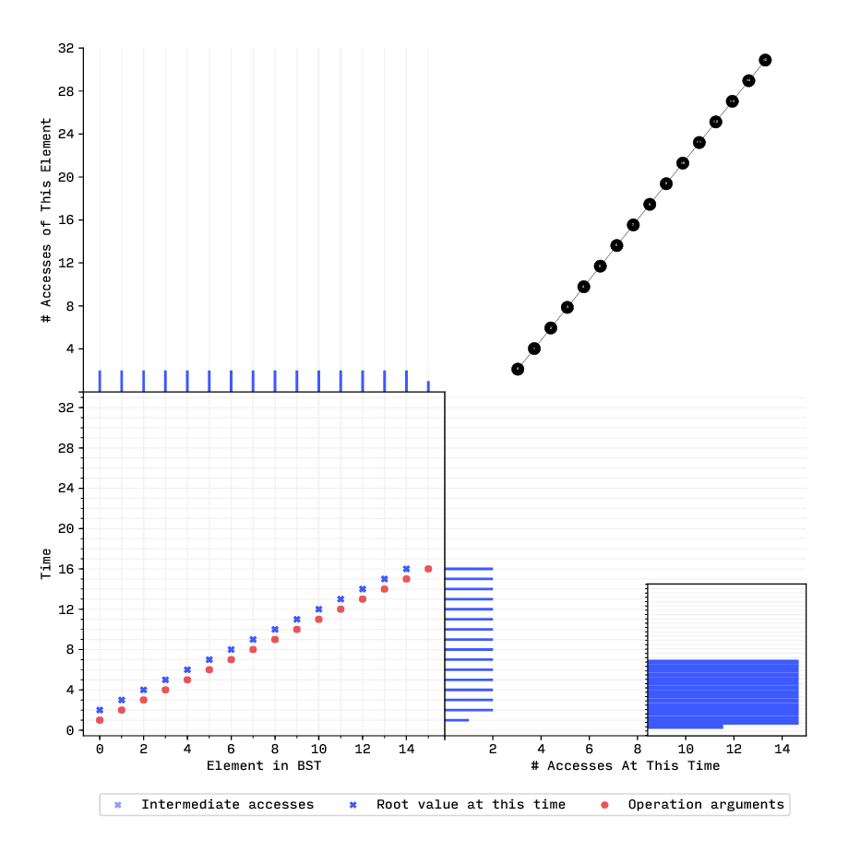
Splay Tree: Increasing Inserts, Increasing Searches

Slide 35
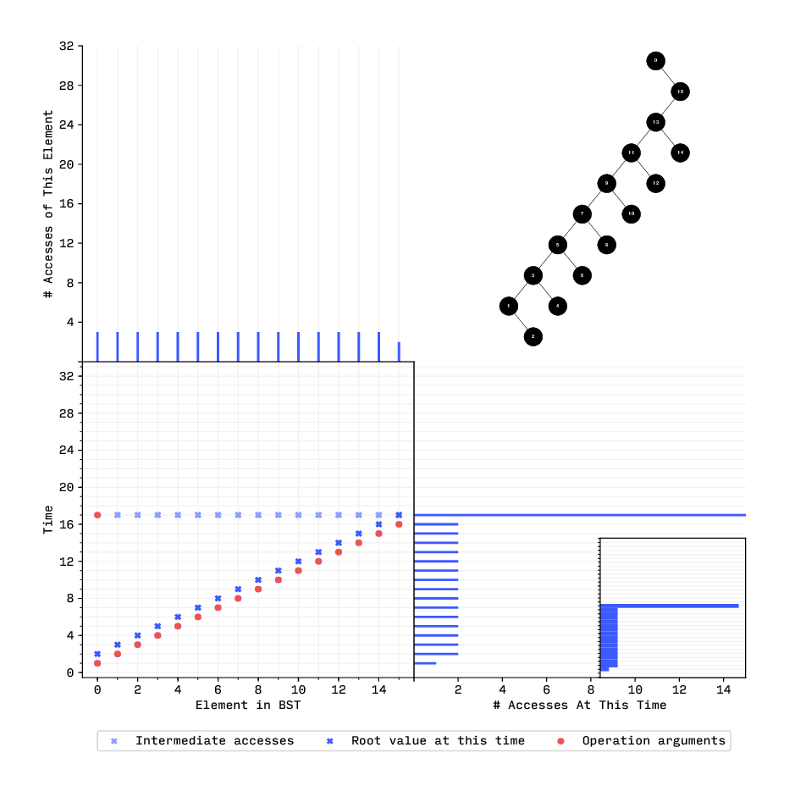
Splay Tree: Increasing Inserts, Increasing Searches

Slide 36
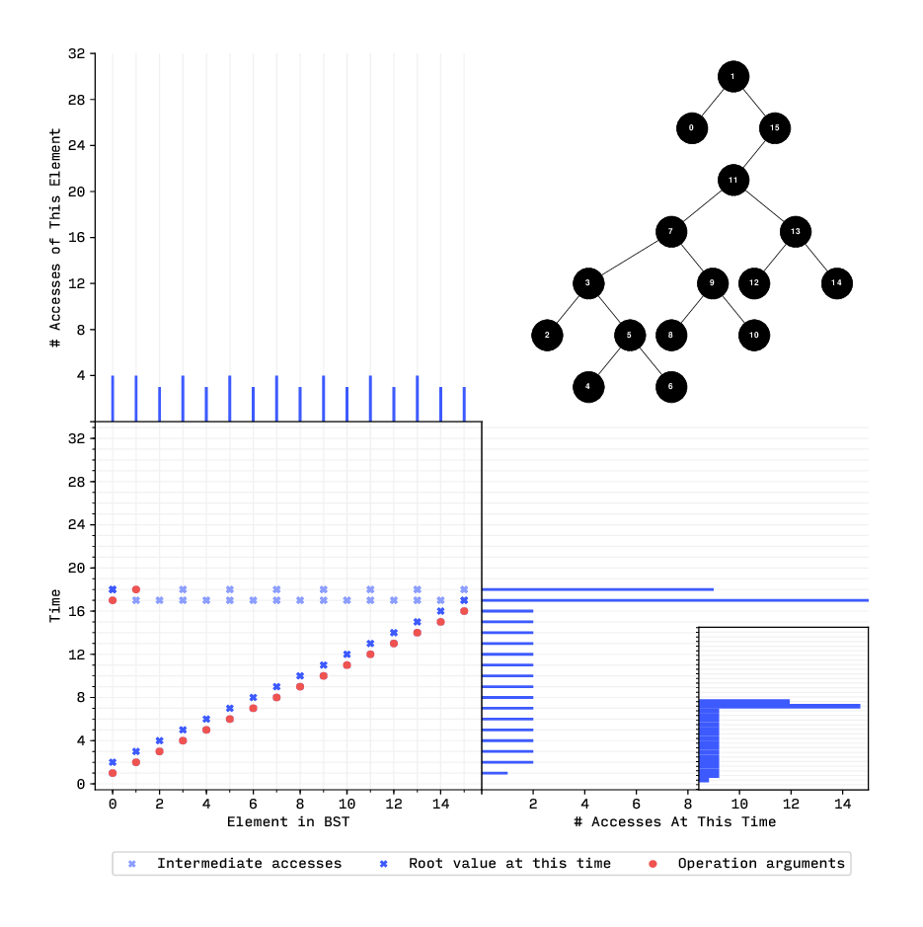
Splay Tree: Increasing Inserts, Increasing Searches

Slide 37
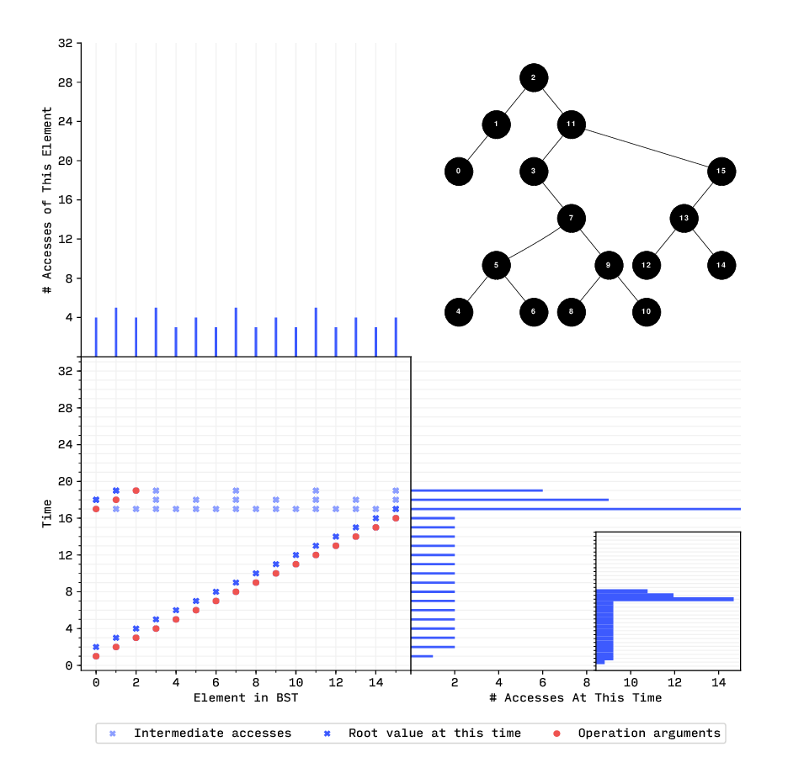
Splay Tree: Increasing Inserts, Increasing Searches

Slide 38
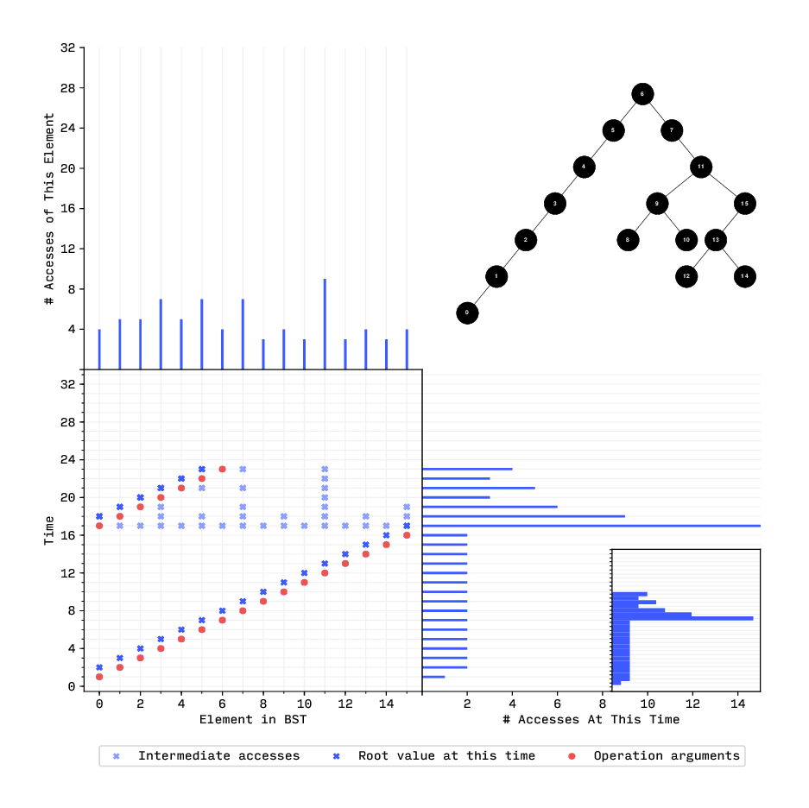
Splay Tree: Increasing Inserts, Increasing Searches

Slide 39
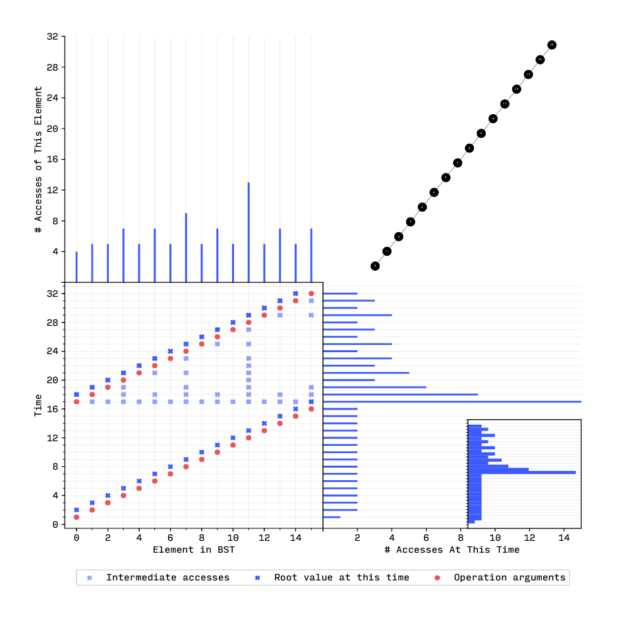
Splay Tree: Increasing Inserts, Increasing Searches

Slide 40
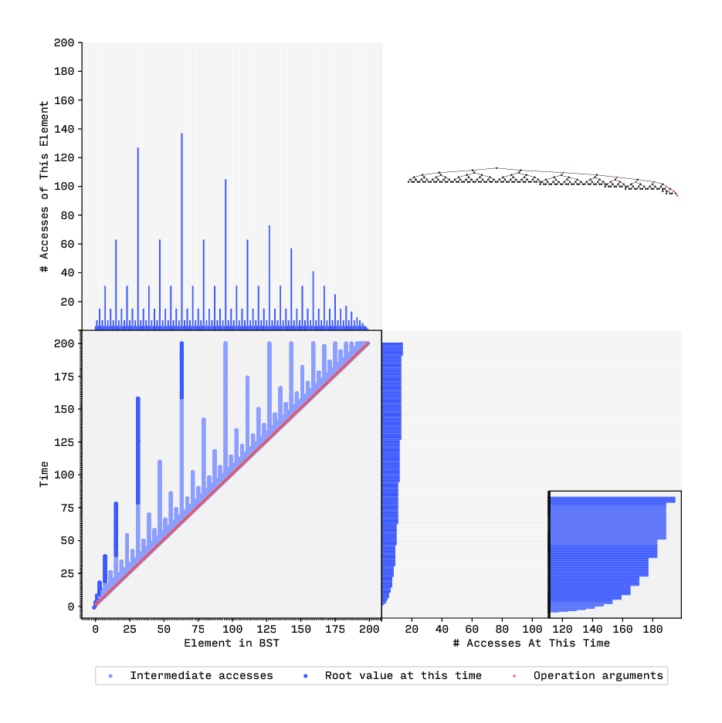
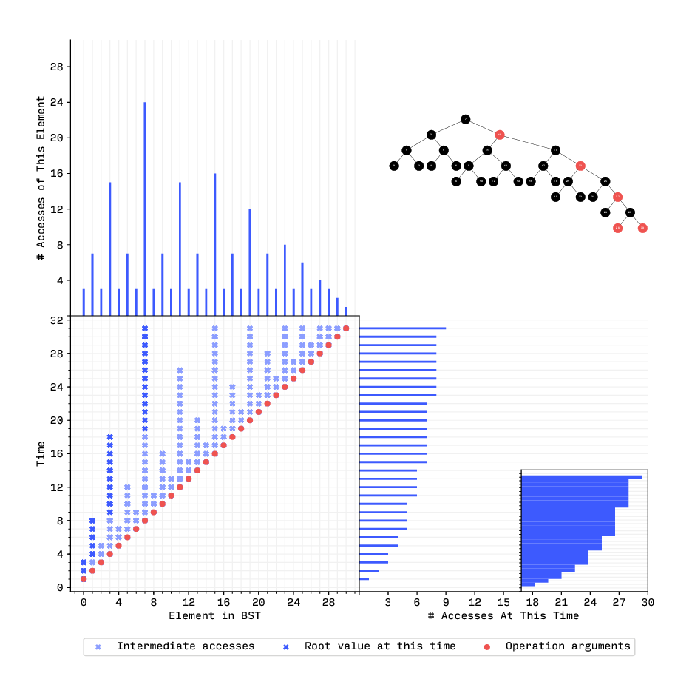
Red–Black Tree: Increasing Inserts

Slide 41
Red–Black Tree: Increasing Inserts

Slide 42
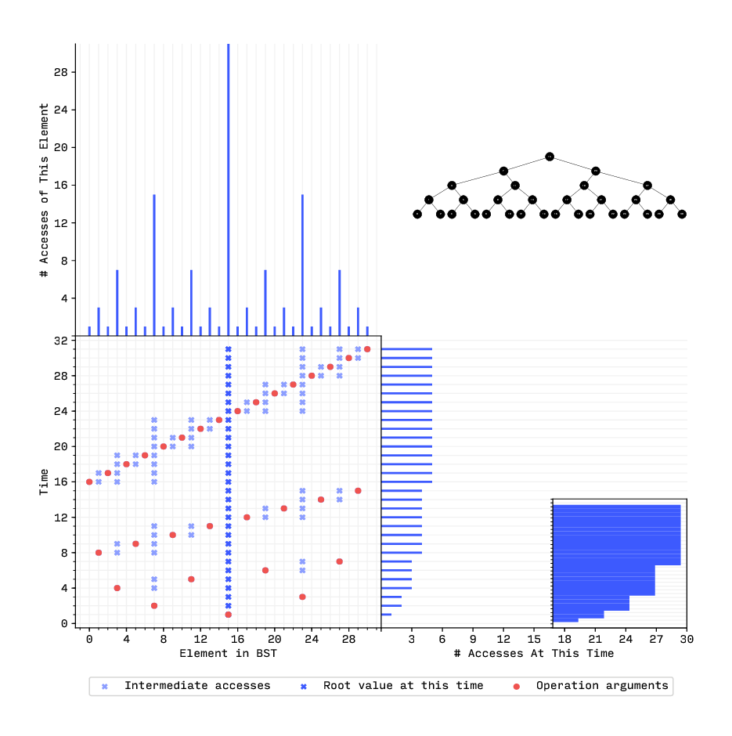
Simple BST: Balanced Inserts

Slide 43
Thank You!
GitHub Repository:
https://github.com/forsooth/BST-analysis

